Slide 1
Montréal International Game Summit
BRAIN DUMP 2 12
Stéphanie
Bouchard
Cord
Smith
Jonathan
Morin
Tim
Sweeney
Alex
Hutchinson
Bernard
Perron
Jonathan
Jacques-
Belletête
Lee
Sheldon
Your humble host:
Richard Rouse III
Microsoft Game Studios
INVENTING
THE FUTURE
Notes:
Bonjour tout le monde!
I hope you had a great MIGS and learned a lot.
But now get ready to have more ideas thrown at you in one hour than you’ve ever had before.

Slide 2
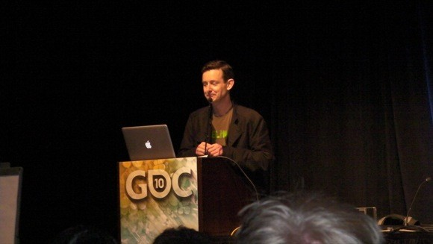
Notes:
The format of this session steals liberally from the format pioneered by Richard Lemarchand at GDC. Fortunately, he gave us his blessing, and much useful advice.
The idea is simple – a bunch of speakers, five minutes each, as many awesome ideas as possible.

Slide 3
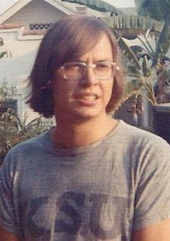
Notes:
We have a number of world renowned speakers at the conference already who we thought it would be fun to intimidate them into doing a second presentation.

Slide 4
Notes:
… along with another group of super interesting developers from around Montreal who were not already speaking at MIGS. Welcome!

Slide 5
The Future.
Unknown.
Notes:
And we thought we should tie this to the theme of the conference.
“The Future. Unknown.”
Not very optimistic, is it – do you want a conference about the unknown?

Slide 6
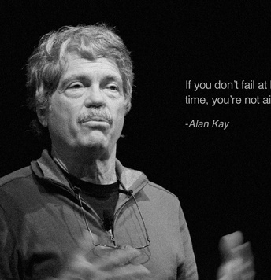
“The best way to predict the future is to invent it.” – Alan Kay
Notes:
Fortunately, we have a solution. We can predict the future by making it ourselves.
Who here knows who Alan Kay is?

Slide 7
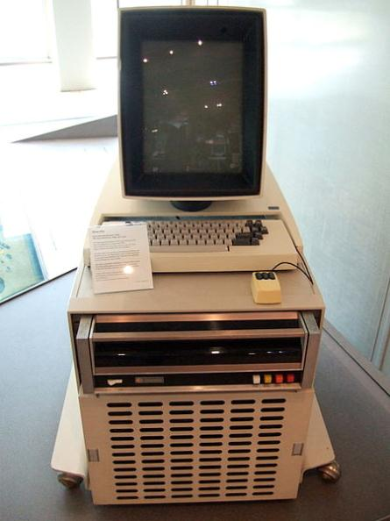
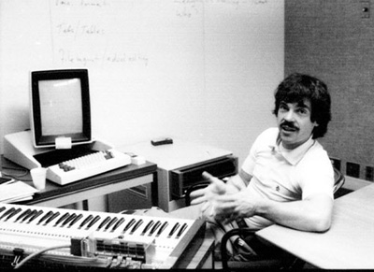
Notes:
Well you should know who Alan Kay is.
He’s one of the most famous computer scientists of all time.
He worked at Xerox PARC in the 60s when they basically invented the future.
Such as the graphical user interface, windowed environments, object oriented programming, an early implementation of the mouse, etc etc.
Very impressive stuff.
This is the Xerox Alto, the computer that ran a lot of that future stuff.

Slide 8
Hard Drive
Notes:
And what I like a lot is that this giant box underneath it is the hard drive. I’m sure it had some obscene amount of storage, like 10 megabytes.

Slide 9
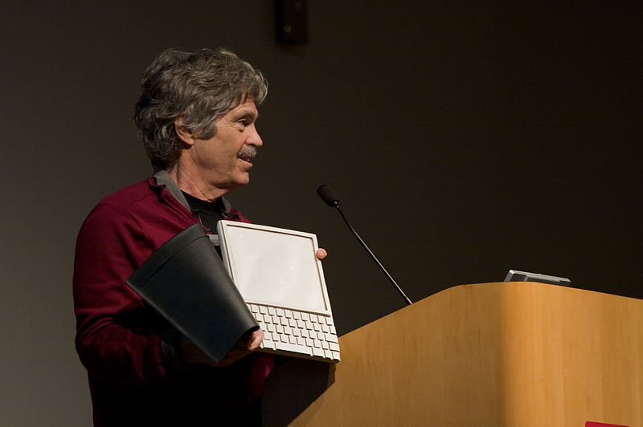
“Dynabook”
Notes:
Alan also created the Dynabook – a tablet device.
Now, you might see that, and think it’s just an iPad/Kindle with a keyboard.

Slide 10
“Dynabook” Designed in 1968.
Notes:
Except he designed it in 1968.
So how is Alan Kay connected to games? Well, not every directly, though in the early 80s, he went to Atari as a research fellow, and started a new department…

Slide 11
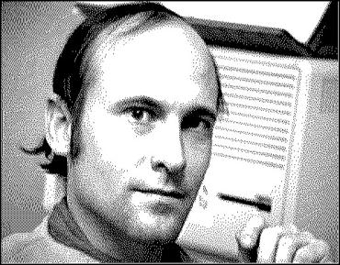
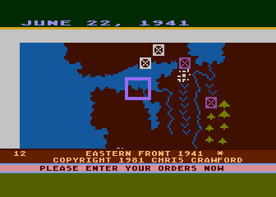
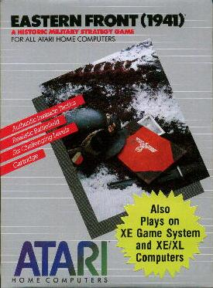
Notes:
To which he hired one Chris Crawford, famous game designer, who I hope many of you have heard of.
Now, at the time, Chris was a bit of a wunderkind in creating a number of hit games, most of them wargames, like Eastern Front (1941).

Slide 12
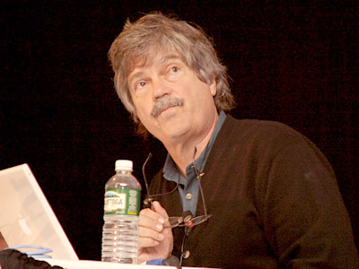
“If you don't fail at least 90 percent of the time, you're not aiming high enough.” – Alan Kay
Notes:
But then Alan Kay brought him over to his department.
Chris tells me Alan didn’t give him much direciton on what to design – but mostly just challenged him to be as creatve as possible. And offered the famous quote above.

Slide 13
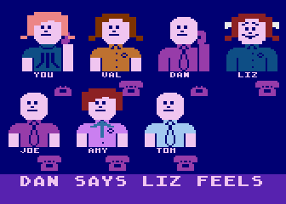
Notes:
Though Chis denies this, the first game Chris made with Alan was his most innovative and off the wall design to date –
really an experimental game about relationships among a bunch of high school kids called Gossip.
Now this game was a commercial failure, but it started Chris in a much more experimental direction.

Slide 14
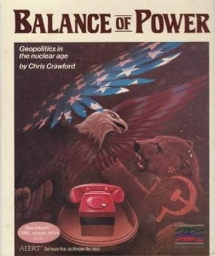
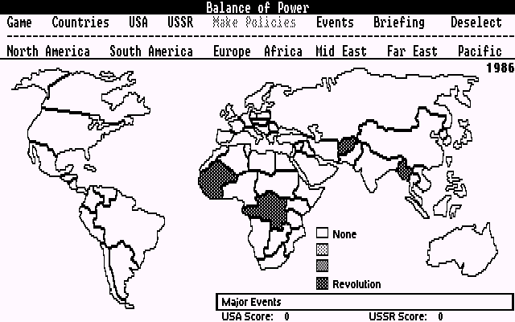
Notes:
This new experimental direction eventually resulting in his breakthrough and best remembered game, Balance of Power – a title unlike anything that had come before – a war game about preventing War.

Slide 15
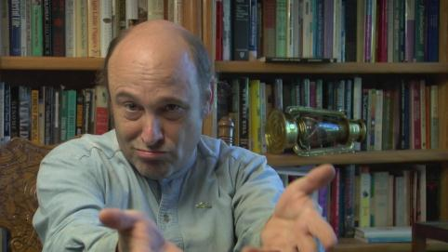
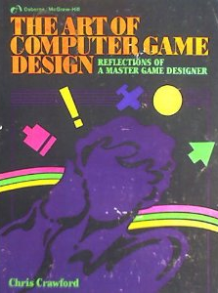
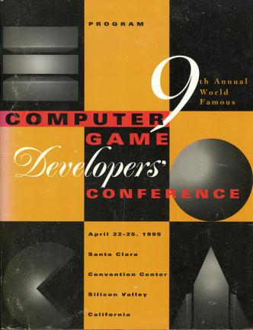
Notes:
And ultimately Chris wrote the first book about computer game design
And founded the Game Developer’s Conference.
Would Chis have done all this without Alan’s inspiring him? Perhaps…
But I think we have to thank Alan Kay at least a little bit for all that.

Slide 16
“Most software today is very much like an Egyptian pyramid with millions of bricks piled on top of each other, with no structural integrity, but just done by brute force and thousands of slaves.” – Alan Kay
Notes:
Here’s another quote from Alan that I think suits the game industry in its current state –

Slide 17
“Most software today is very much like an Egyptian pyramid with millions of bricks piled on top of each other, with no structural integrity, but just done by brute force and thousands of slaves.” – Alan Kay
Sound familiar?
Notes:
Sound familiar to anyone out there working on giant projects?

Slide 18
Notes:
But I think something we can all take a page from is Alan Kay’s point of view on what is the most useful quality in a person in terms of having an impact on their society.
These slides are taken from a talk Alan did -
Leonardo da Vinci (left) invented a lot of stuff, but contrary to what Assassin’s Creed may lead you to believe, he made a lot of crazy inventions that were either impractical for hundreds of years, vastly oustripping the capabilities of his time – or never would work at all. He didn’t have enough knowledge and outlook to make things that could really change the world.
Henry Ford (center) not nearly as smart, but born in a better century – he perfectly leveraged the technology of the day, figured out a way to mass produce it, and changed the world.
Or then you have Newton – whose ideas were a perfect blending of what had come before with enough new ideas that he became probably the most influential physicist of all time, completely transforming the way of scientific thought, and transforming our world.

Slide 19
Notes:
It was Newton’s outlook – and ability to understand his time, synthesize knowledge, and bring new ideas in – that made him so successful.

Slide 20
Notes:
IQ without foundation and perspective doesn’t get you very far. Outlook is everything (when you have knowledge).

Slide 21
Notes:
And that’s what we’re looking for in today’s speakers – knowledge of where we are as an industry and then pivoting to where we are likely to go next, a unique knowledge to predict the future.
You can’t just steal their IQs, but you can learn a ton from their outlook.

Slide 22
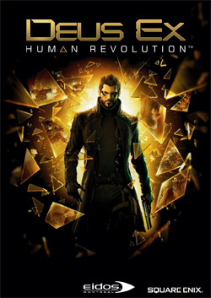
JONATHAN
JACQUES-BELLETETE
Art Director Eidos Montreal

Slide 23
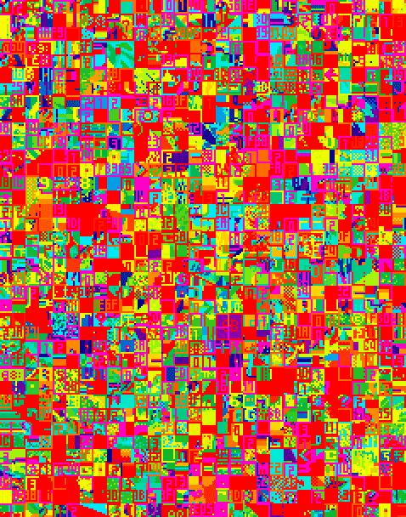
The video game industry must go to aesthetic rehab

Slide 24
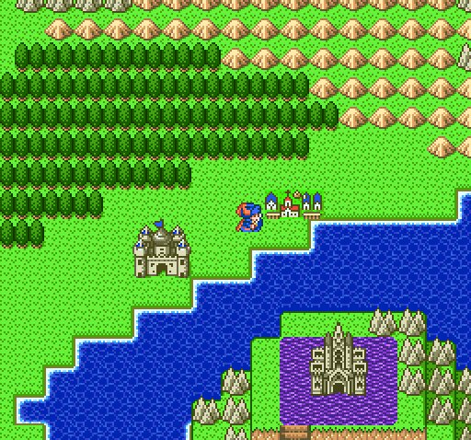
We live in some kind of air sealed visual parallel universe.
Videogame visuals

Slide 25
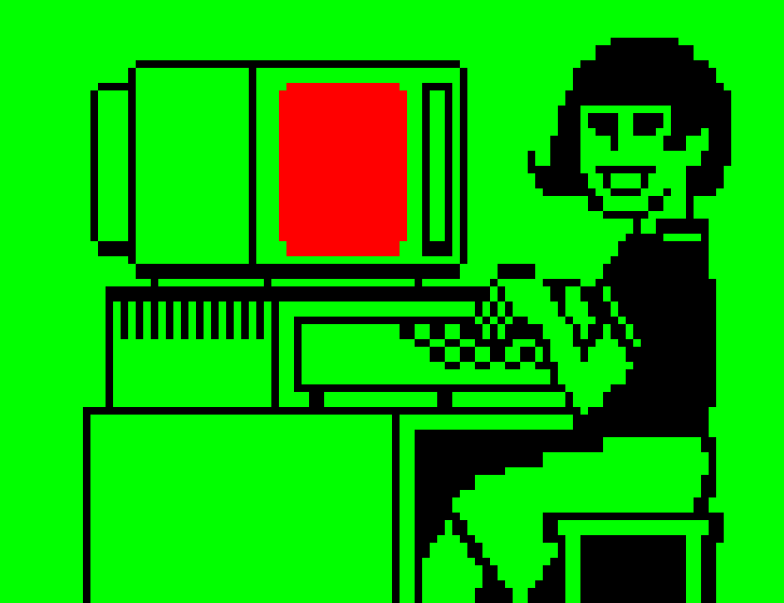
Our visual culture is completely outdated!!!!!

Slide 26
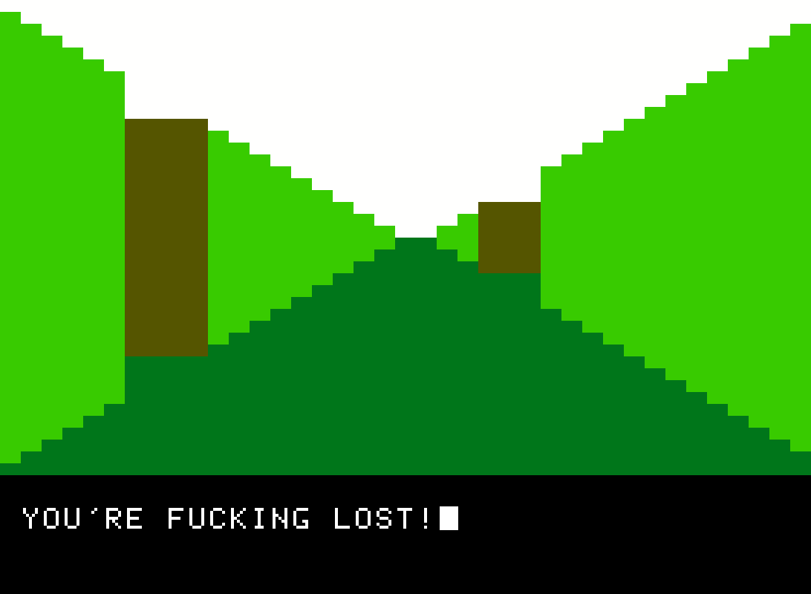
Our visual culture hasn’t stepped out of its parents’ basement in 25 years.
WE’RE FUCKING LOST!

Slide 27
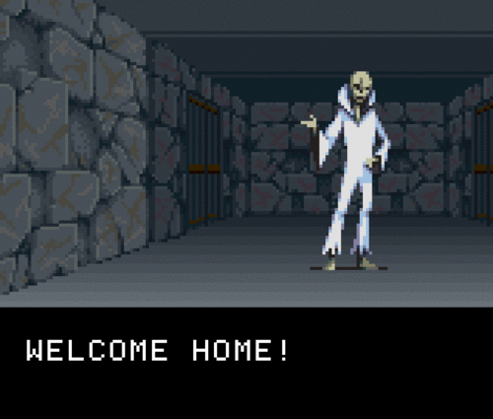
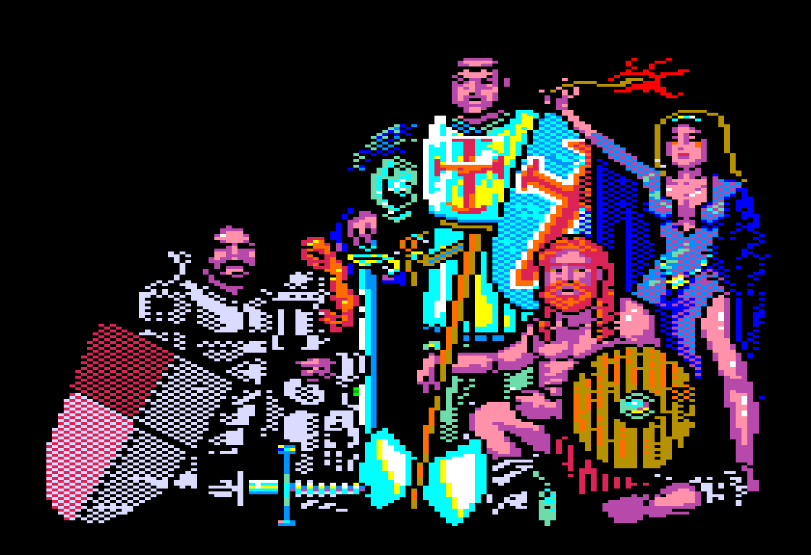
YEEEEEH!!!!

Slide 28
We must start looking at
new sources of inspiration

Slide 29
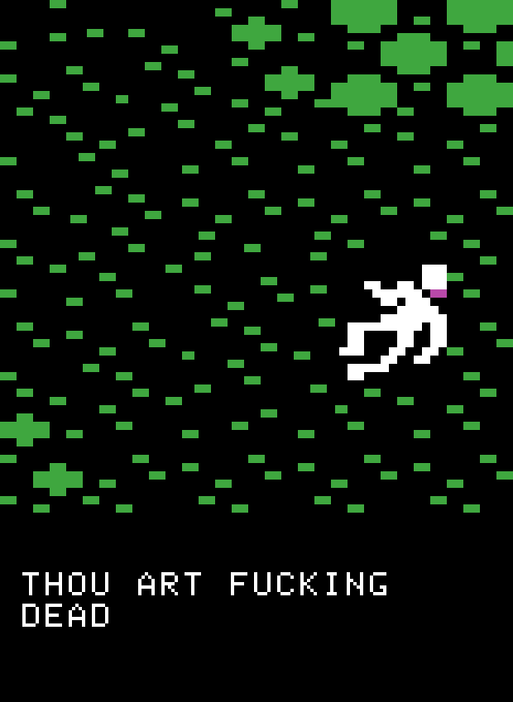

Slide 30
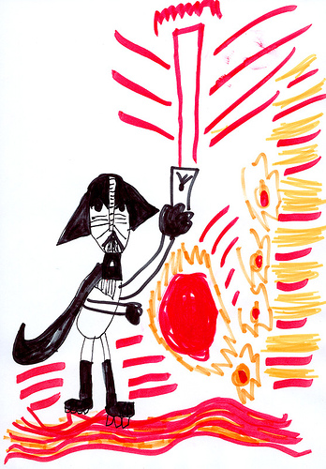

Slide 31
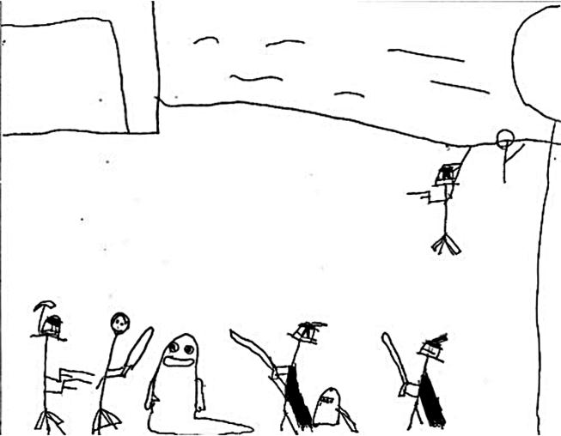

Slide 32
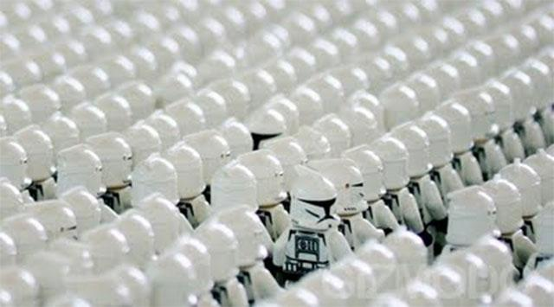

Slide 33
You get nothing original from an echo
Notes:
and not only are we still just trying to recreate these things, we like to imitate one another recreating these things.

Slide 34
Notes:
and not only are we still just trying to recreate these things, we like to imitate one another recreating these things.

Slide 35
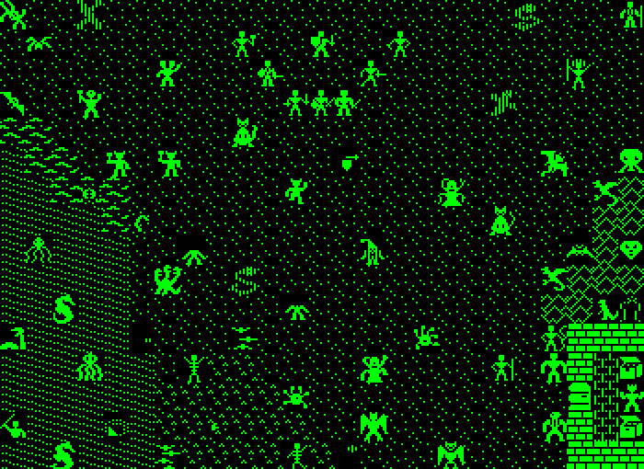
Paul Klee once described an artist as being like
a tree, drawing the minerals of experience from its
roots. Things observed, read, told, and felt.
Notes:
and not only are we still just trying to recreate these things, we like to imitate one another recreating these things.

Slide 36
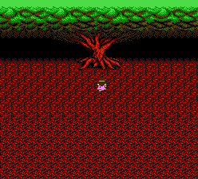
the tree of second source material
Outdated
fantasy and
sci-fi visuals
Star wars
Dungeons and dragons
Other
videogames
Comics
Hollywood movies

Slide 37
the tree of original material
Personal
experiences
Crazy shit
Contemporary design
Visual metaphors
Contemporary arts
Art
exhibitions

Slide 39
reflective design

Slide 40
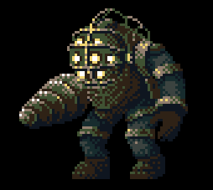

Slide 41
YEEEEEH!!!!

Slide 42
Design distinctions create desire

Slide 46
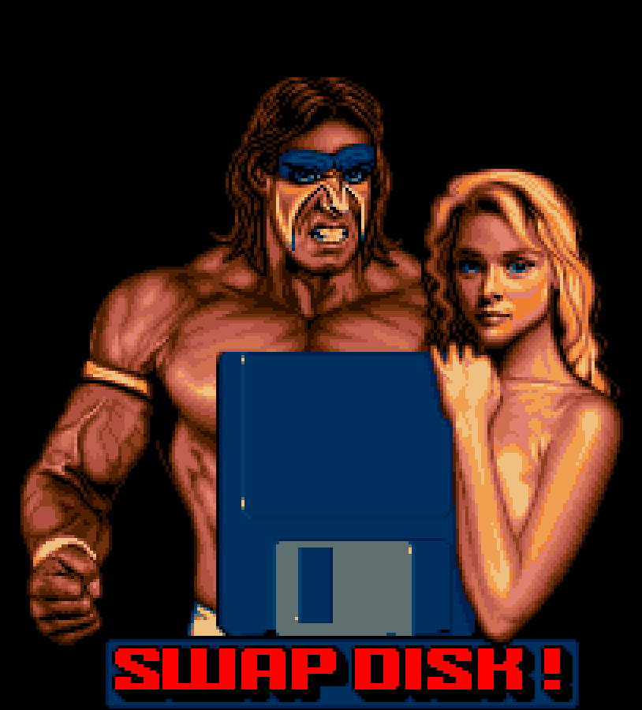
In the future I would like to see our industry break away from this outdated visual culture

Slide 47
ORIGINALITY
mixed with
FAMILIARITY

Slide 48
ORIGINALITY promotes brand memory indirectly through increased levels of attention and reflective design

Slide 49
FAMILIARITY creates feelings of comfort, security, and nostalgia

Slide 50
Vision is the art of seeing the invisible.

Slide 51
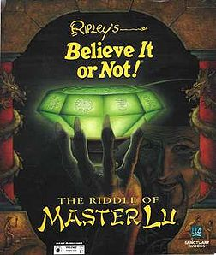
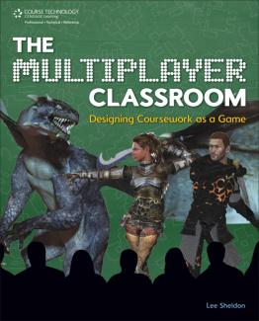
LEE
SHELDON
Associate Professor
Rensselaer Polytechnic Institute

Slide 52
Inventing the Future: MIGS Brain Dump 14 November 2012
Writing
Lee Sheldon

Slide 53
Past

Slide 54
In the beginning was the word.
West of House
You are standing in an open field west of a white house with a boarded front door. There is a small mailbox here.

Slide 55
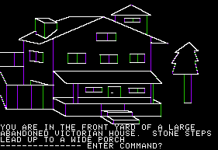
Then a picture was worth a thousand of them.

Slide 56
Present

Slide 57
Clichés

Slide 58
Stereotypes

Slide 59
Cinematics
Story Ghettos

Slide 60
Text Dumps
Reasons to ESC

Slide 61
Linear storytelling
Notes:
Odyssey. Homer. Non-Linear Bardic Storytelling was alive and well 30 centuries ago

Slide 62
You might conclude that...

Slide 63
Writers are either…

Slide 64
Lazy,

Slide 65
Ignorant,

Slide 66
or ignored.
Notes:
How can this be?

Slide 67
Technology moves so fast!

Slide 68
Technology is only now good enough to tell stories!
Notes:
Get beyond technology. Use the force, Luke!

Slide 69
Past

Slide 70
The Great Train Robbery
1903

Slide 71
Birth of a Nation
1915

Slide 72
12 Years

Slide 73
Colossal Cave
1976

Slide 74
Today
2012

Slide 75
36 Years
3 Times as long as the Movies

Slide 76
It’s not the technology. It’s us.

Slide 77
West of House
You are standing in an open field west of a white house with a boarded front door. There is a small mailbox here.
> Go East
108 characters including heading.

Slide 78
Present
New Mediums
Notes:
We’re there again.

Slide 79
Creators are more creative the tighter the parameters.

Slide 80
A relationship in 10 tweets.

Slide 81
(EMILY IDLE) My beau back in the states is a librarian. Every time I smell an old book, I think of him.
(EMILY IDLE) Oh, {playername}, my beau doesn’t think jungles and romance mix! Hasn’t he heard of Tarzan and Jane???
(EMILY IDLE) Long distance relationships are not easy!
(KEN IDLE) I think Emily’s having some trouble with her beau. She’d be better off with an army man than a librarian. Yessir!
(EMILY IDLE) {playername}, if you’re heading back into the jungle, I may have a personal favor to ask…
(QUEST BESTOW) My beau back home is growing aloof. But I’ve found the recipe for an ancient love potion!
(QUEST REWARD) Oh, thank you, {playername}! This should make Jim’s heart grow fonder! I am in your debt!
(EMILY IDLE) {playername}, thank you for the love potion! I sent it to my beau in a box of candy!
(EMILY IDLE) I really don’t want to talk right now, {playername}. The love potion gave my beau Montezuma’s Revenge!
(KEN IDLE) One thing I’ve learned from Emily’s love life: if she offers you candy, turn it down!
Notes:
In the first three idles we can already see an unhappy shift in her relationship. Another NPC has observed the same thing:

Slide 82
A story in 3 dialogue trees.

Slide 83
STORY: Meet the Delegates
Story Encounter: FED_S_0001_LandOfTheBlind_01_MeetDelegates.atm
Away team is assembled and beamed to the planet’s capital city
Learn of unplanned T6 meeting – an assembly of national leaders
Player learns of Talen culture—the seductive qualities of the Talens, and their Hospitality Delegations, which have been compared to Earth geishas, but include members of both sexes. The entire population is blind.
STORY: Shuttle and Custody
Story encounter: FED_S_0001_LandOfTheBlind_02_ShuttleAndCustody.atm
A small shuttle craft is homing in on the player’s starship; it appears to contain a small child of human or Talen origin
The away team is brought into custody for unexplained reasons; they are unwilling to defend themselves as they have become too emotionally attached to their captors.
STORY: Save Bekka
Story encounter: FED_S_0001_LandOfTheBlind_03_SaveBekka.atm
Bekka, a Talen child with functioning eyes, hails the ship and asks to come on board. The player can refuse to the point that she crashes into the ship and dies, or beam her onboard
The T6 have decided to hold the away team hostage until they receive Bekka in exchange
The T6 discover that both of Bekka’s parents are Talen and that there has been a change in the genes of the entire population that is causing the birth of Talen with working eyes. The Talen agree to reassess how they will deal with this to learn to live with the new minority.

Slide 84
For sale
Baby shoes
Never worn

Slide 85
Future

Slide 86
We will…

Slide 87
Forget AI.

Slide 88
Stop looking for excuses to be
Lazy
Ignorant
Ignored

Slide 89
Stop pretending we invented stuff people have been doing for centuries.

Slide 90
Learn from the past.

Slide 91
Learn the craft.

Slide 92
Wed story and gameplay.
They are NOT enemies

Slide 93
Construct narrative the way players play.
Modular
Systemic

Slide 94
Wed authorial and emergent storytelling.
They are NOT enemies

Slide 95
Adapt to new mediums.

Slide 96
Experiment!

Slide 97
37 Story Delivery Systems
Cut Scenes created with game engine
Cinematics created with codec
Books
Journals
Codexes
Item Descriptions
Signs/Plaques
Dialogue with NPCs
Overheard Conversations
Dialogue Directed at Mute PC
Narration
Reactive narrative keyed to player actions
Barks
Graffiti
Flavor text
Loading screen
Documentation
Story setup text
Pre-recorded audio
Radios (DJs, squad-chatter)
Observed Incidents
Organics
Weather
Architecture
Decorations
Home Furnishings
Location
Video monitors (live and pre-recorded)
Clothing
Accessories
Body Art
Grooming
Titles
NPC non-verbal attitudes
Emotes
Tombstone Epitaphs
Menu choices
Notes:
3 students came up with these in less than half an hour. If you don’t use at least half of these in your new AAA title, you suck!

Slide 98
We will write better.
You know you can.

Slide 99
Period.

Slide 100
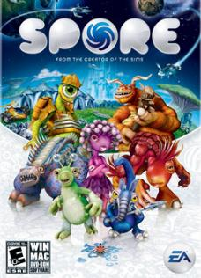
ALEX
HUTCHINSON
Creative Director Ubisoft Montreal

Slide 101
Notes:
Hello my name is Alex Hutchinson etc...
But I start, let me tell you what my talk is not..

Slide 102
Notes:
It is not a talk about whether video games are art.
Of course they are, and if you can’t agree that the combination of images, sounds and interactivity has the possibility of creating art, then you are a deeply confused person.
We could argue about whether or not the games currently produced are art, but this is another question.
There are of course some people who will never get it, and honestly, we just need to wait for those people to die.
But there are also millions of reasonable people out there who should either love games, or at the very least understand why YOU love games in the same way that I understand why some people love Opera and get a lot out of it, even though I can’t sit through ten minutes of it. So why do they think that?
You can think of this mini-talk as a list of things I don’t think we should ever talk about again.
So thanks in advance for not speaking to me after this talk.

Slide 103
Notes:
I’m not saying this to be flippant.
I honestly believe when we talk about games, we almost always talk about the wrong thing and we confuse the hell out of normal people, and lead ourselves into tiny little ghettos of internet conversations which distract us from REAL conversations we should be having
if we want other people than those who exist in our own little echo chamber of ‘hardcore players’ to care about games, and consequently, if we want our art form to grow.

Slide 104
Notes:
Firstly, we talk way too much about technology.
If anyone ever asks me again how many polys the character onscreen has, how how many meters the draw distance is, I may hurt you.
Technology is an enabler: it allows us to express ideas. And it’s hard to do right, and it’s beautiful, and honestly some of my best friends are programmers
But technology should be invisible to the player.
Ask me why we made this character exist at all! Ask me why seeing all the way to the end of the street is useful! Maybe it's not! This isn't an arms race... This is a creative process.

Slide 105
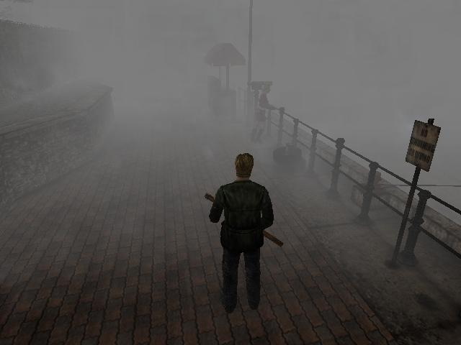
Notes:
Silent Hill made terrible technology into a great game, dousing the whole world in fog.
It gave you a sense of claustrophobia, it made you terrified of the world as it started to loom toward you out of the fog.

Slide 106
Notes:
We also need to stop talking about features like it’s a competition where the longest list wins.
You would not believe how many times, especially in Germany, I am asked how many levels there are. Or how many weapons there are. Or how many types of grain can be traded in the game.
A game is not a list of its parts! More is not always better!
Shouldn’t the question should be are they the right weapons, or are there are enough levels to satisfyingly deliver on the core goals of the game.
Or perhaps, is grain even an appropriate trading commodity for this particular game?

Slide 107
Notes:
If you’re a reviewer, you need to stop asking yourself if you personally really like the game.
A review that merely tells me whether you like the game or not is less than worthless to me as a player, even if you list the reasons for it. I don’t care if YOU like it. When did every reviewer decide they were Hunter S. Thompson? This is a cheap and easy way to review a game.
How does it help a player decide whether a game is worth their time or not?
Surely the role of a review is to outline what the game was aiming to do and whether it achieved it?
In my opinion it is our job as a developer to make it clear what our aims were either implicitly, or less awesomely explicitly, and then for the reviewer to articulate whether we succeeded or failed: there’s room for subjectivity, but it’s the least important thing.
Unless you’re Hunter S. Thompson. And you’re not.

Slide 108
Notes:
I am not personally interested in Barbie or her Dreamhouse, but I can guarantee you that if someone made a perfect replica of the whole thing where you could peer into every room and pick up every tiny shoe and essentially relive in perfect replica the real world experience of owning and collecting and playing with Barbies, then it would thoroughly deserve the 10/10 that nobody would give it.
And let’s not even get into why on earth any review still has an individual rating for ‘graphics’ whatever that means.

Slide 109
Notes:
We talk too much about business.
There’s a place for this, probably amongst business people. And there’s a percentage of the audience who is interested and it probably even includes a lot of you.
But you are people who attend industry events, and read Eurogamer.
This is a tiny fraction of our current audience, let alone our potential audience.
I’ll give you a thought: if you make a game that sells more than a few million, you are already outside of the hardcore. Which means they don’t read websites, don’t read magazines, probably shop at Walmart, and don’t care about the ‘future’ of the industry: they just want to be entertained, or challenged, or otherwise convinced to try the game.

Slide 110
Notes:
I hesitated to include this one as we’ve already generally improved on this, but we used to talk about this amorphous idea of ‘fun’ as though it was the only success axis in our medium!
What kind of serious medium has fun as its only ore goal? Fun is a possible goal and an admirable one but it’s hardly the only positive adjective we can come up with, and anyway, don’t you want more than that?
Don’t you occasionally want to be challenged? To be forced to stop and think?
I want a game that truly upsets me. I want a game that’s uncomfortable to play, that makes me think about how in an interactive medium I am actually complicit in the decisions I am making.
I want a game that is deliberately UN-fun. I might even try to make one.

Slide 111
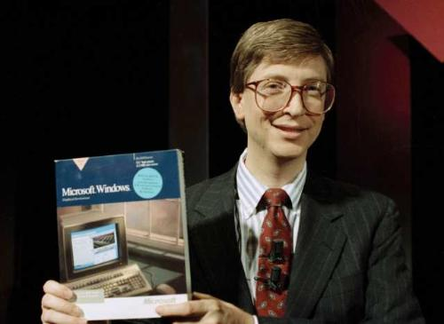
Notes:
Before everyone thought Steve Jobs was the god of technology, everyone thought it was Bill Gates, and he wrote in an essay in 1996 that ‘content is king’ - and this remains true and in will always be true.
I've spoken before about how you as a developer at a public company need to keep an eye on sales: it's your job to make it happen or soon you won't have a job anymore. But that was at a developer discussion, and I gave the talk to other developers.
In fact all of the topics I’ve listed are valid and worthy discussions for those of us working in the business – but they should not be even 1% of the player facing commentary we make. We need to talk to our potential players about content.
We talk to our audience as though they themselves are developers…

Slide 112
Average Developer
Average Reviewer
Average Player
Notes:
Which I think this stems from the earliest days of our scene, where developers, reviewersand players were all essentially the same people.
We need to stop talking about all the irrelevant dribble surrounding games, focus on content and communicate on higher level questions that are interesting and worthwhile to us as people, not developers.
We need to talk about why we made the creative choices we did.
We need to talk about what we hope our audience will keep with them years from now when they think back on our game.
We need to talk about long term creative goals for ourselves and the medium.
Thopefully then I’ll finally get to stop reading the same irritating article about whether or not games are art.

Slide 114
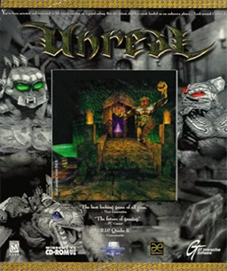
TIM
SWEENEY
Founder/CTO Epic Games
Notes:
[Tim had no slides – guess you had to be there!]

Slide 115
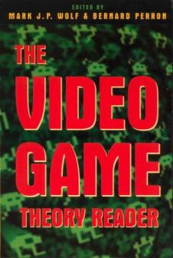
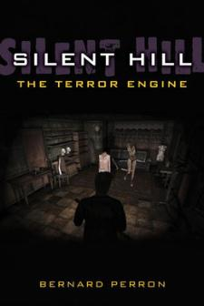
BERNARD
PERRON
Professor Université de Montréal

Slide 116
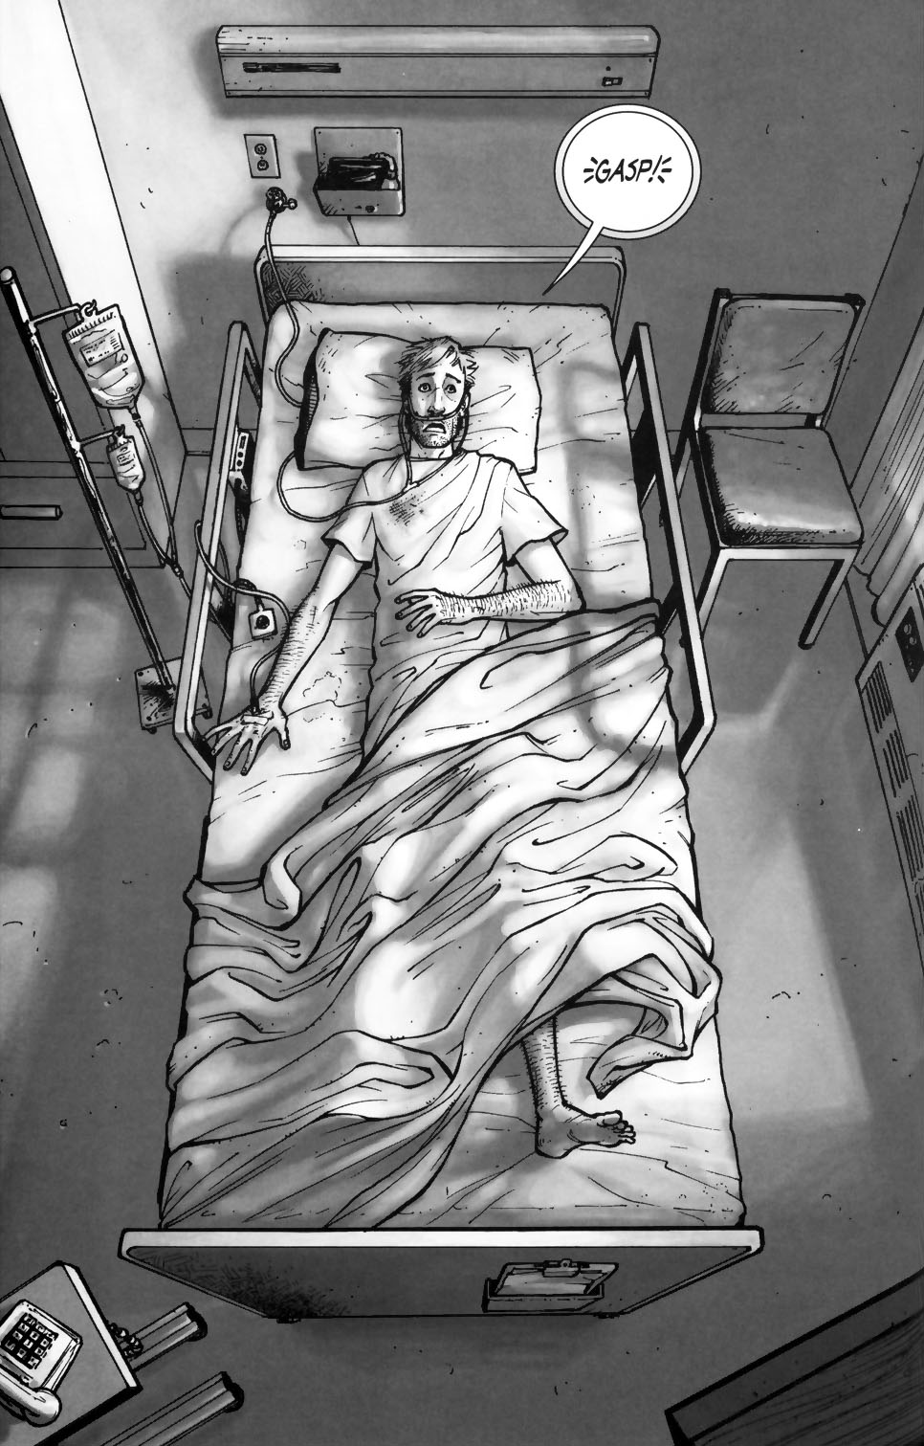
October 2003
October 2012
#1
#103

Slide 117
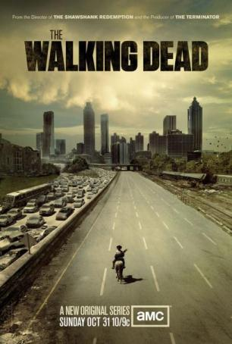
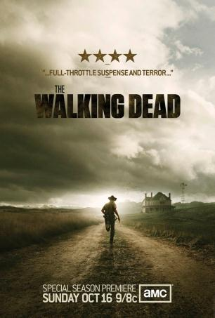
Season 1
Season 2
Season 3
2010
2013

Slide 118
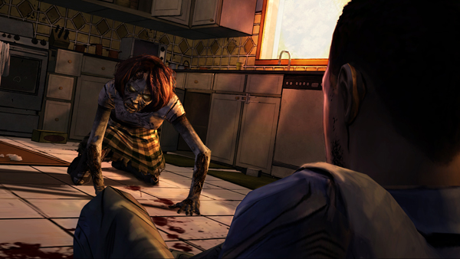
... of Interactive Movies.

Slide 120
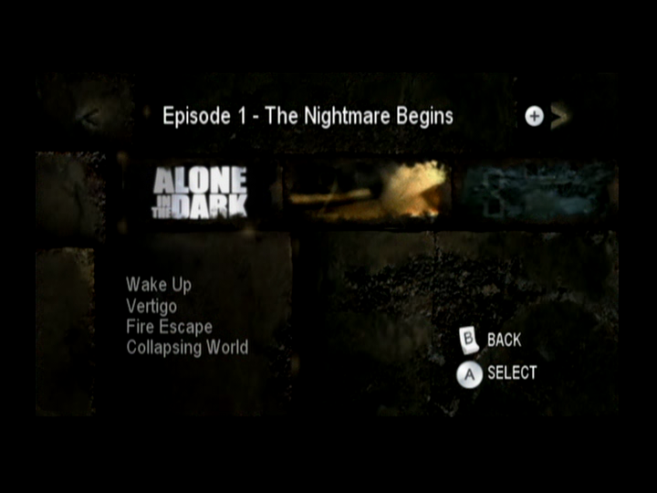
(June 20, 2008)

Slide 121
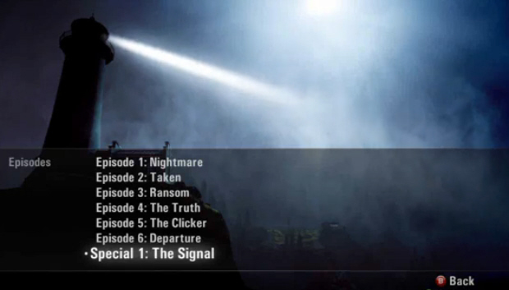
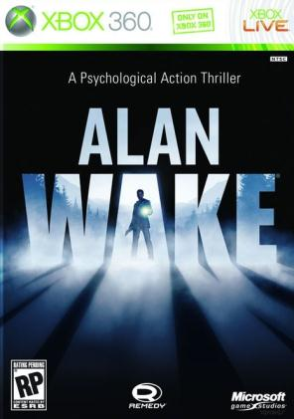
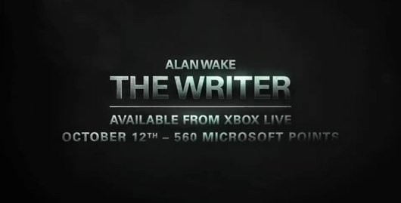
(DLC)
(May 18, 2010)

Slide 122
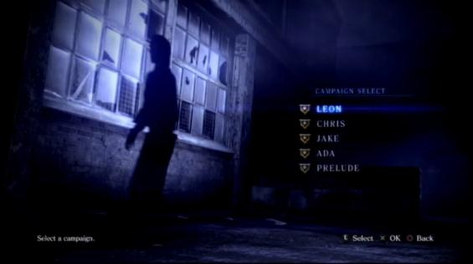
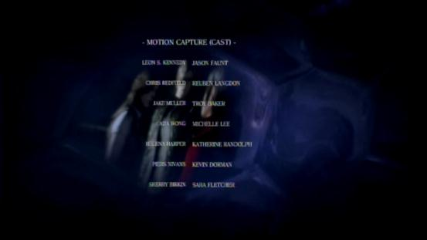
(October 2, 2012)

Slide 123
(August 27, 1998)
(1913-1914)
Notes:
Pulp adventures = one a month for 32 months between 1911 and 1913
Fantômas = Serial in three episodes. Released April 1913.

Slide 124
(2006-2007)
(2010-2011)
(2011-2012)

Slide 125
April 27, 2012
June 27, 2012
Aug. 28, 2012
Oct. 9, 2012

Slide 126
(October 2, 2012)

Slide 127
(October 2, 2012)

Slide 131
Episode 1
Yeah.. You’re right. You know guys, I think it’s going to be ok.

Slide 132
Episode 2

Slide 133
Episode 1
Episode 2

Slide 134
Small, Simple & Smart is Beautiful
Small, Simple & Smart is Beautiful
VG Series / Shows Remain a Bright Horizon
VG Series / Shows Remain a Bright Horizon
Notes:
Small Is Beautiful: Economics As If People Mattered by British economist E. F. Schumacher (1973).

Slide 135
STEPHANIE
BOUCHARD
Game Designer THQ Montreal

Slide 136
The future of video games
Reaching the other end of the spectrum
Notes:
Hi My name Game Designer - THQ - Desilets' Project
Game Design Teacher for Dawson College

Slide 137
After photorealism and surround sound
Human Emotional Depth
Lets explore why current games feel a little hollow
Notes:
Do not let the fact that my body produce estrogen fool you. This is not a feminist talk!

Slide 138
Video Games are a Continuum...
?
Physical
Notes:
What is going on with the Real Games Industry?

Slide 139
So what is the other pole?
Strength comes from:
Building a social web
Nurturing relationships
knowledge repository
Talent and skill repository
Tap into soft skills resources
Empowering Others, empowers you
Know their limits
Team up with people with complementary skills
Social Engineers!
high level of empathy,
capacity of projection and prediction
human emotion reading...
and how to use them...
Different type or power
Notes:
-Louis CK
Raising a boy is different from raising a girl:
Boys do damage you can count in $$$ like a hurricane
Girls leave scars in your psyche that you will find later... like a genocide
So typically female right? The godfather
Even the extortion system is violence based

Slide 140
How does this influence our game mechanics?
=
=
Politics
Evil Scheming
Psychological Torture
Public Shaming
Seduction
Information Collection
Sex
Drama
subtle Emotion Reading!
Case Study
Kill Button
Creating the Tools
to impact the game this way
Notes:
Mechanics
Characters
acknowledge, remember, create conflicts, gain influence
just talk them into killing each other...
or themselves...

Slide 141
The beginning of an ecosystem
60$
AAA
GamePad
offline
60 mins
Physical
Social
60h
online
Indie
NUI
Free to play

Slide 142
Making Games more humans
Customizing the game experience to enable social manipulations on other characters..
May they be NPCs...
Or other players

Slide 143
CORD
SMITH
Director of Marketing Square Enix

Slide 144
Hi, I’m Cord Smith

Slide 145
Everything I know about the future of gaming...
…I learned in an 80s arcade.

Slide 146
Notes:
In the future, lazy people will prefer to sit while playing their games

Slide 147
Notes:
In the future, competition will become an important factor, mimicking athletics

Slide 148
Notes:
Fighting games will finally gain a proper fan base

Slide 149
Notes:
Miraculously, the NBA will finally seem exciting

Slide 150
Notes:
In the future, co-op gaming will finally catch on…

Slide 151
Notes:
Co-opetition will also finally gain traction…

Slide 152
Notes:
In the future, games will be audience-aware, talking down to the player, mocking him, and making all of us feel like the inferior little blood sacks we are

Slide 153
Notes:
In the future, consumers will demand choice

Slide 154
Notes:
In the future, firearms and shooting things will prove popular

Slide 155
Notes:
The only way to improve upon bigger guns, faster firing rates, and incredibly loud butt rock music

Slide 156
Notes:
Is to add zombies. It is a law of the universe: humans never tire of zombies.

Slide 157
Notes:
Not content to just shoot things, consumers—American consumers in particular--will demand that games flip the script, allowing them to eat things instead

Slide 158
Notes:
In the future, immersion will become so important that new technologies like 3D and holographics will be developed to make players feel as though they are in the game.

Slide 159
Notes:
In light of the ridiculousness of players flailing their limbs in mid-air, games in the future will no longer be controlled by your movements. Instead, games will actually move you.

Slide 160
Notes:
Gamers of the future will finally live out the fantasy of starring in a cartoon.

Slide 161
Notes:
Games of the future will be educational, often teaching life lessons. For instance, the only way to succeed in high school is to repeatedly head-butt your teacher…

Slide 162
Notes:
You might receive training for thankless part-time employment…

Slide 163
Notes:
Prepare yourself for performing redundant tasks for minimum wage…

Slide 164
Notes:
Develop a drinking problem…

Slide 165
Notes:
Investigate alternative career opportunities…

Slide 166
Notes:
And even practice your escape plan.

Slide 167
Notes:
So maybe life doesn’t work out for you in the future. That’s okay. Extra special games will teach you about love.

Slide 168
Notes:
FYI: Microtransactions will remain popular in the future

Slide 169
Notes:
As will subscriptions

Slide 170
Notes:
Of course, you’ll want to save some of that money, since in the future, no one—and I mean no one—will ever have enough nitro.

Slide 171
Notes:
Games of the future will provide convincing evidence that outer space is always a bad idea.

Slide 172
Notes:
This is primarily due to all the mechanic bug creatures that dive bomb and shoot at you

Slide 173
Notes:
NOTE: Some of these bugs have tractor beams.

Slide 174
Notes:
Even driving in outer space is not recommended.

Slide 175
Notes:
In spite of Far Sight’s amazing digital re-creations…

Slide 176
Notes:
The future will long for its own tactile age…

Slide 177
Notes:
Think about it, guys, this machine actually blows you

Slide 178
Notes:
In the future, dual-stick controls will prove popular…

Slide 179
Notes:
As will virtual cash, blood & gore, and bad puns

Slide 180
Notes:
Future games will strive for simplicity of design.

Slide 181
Notes:
Pin it on your walls, friends.

Slide 182
Notes:
Due to over-reliance, devs in the future will run so low on pixels as to cause “The Great Block Shortage of 2027”

Slide 183
Notes:
In the future, your 16:9 can choke on my 4:1

Slide 184
Notes:
Weird may just equal wonderful…

Slide 185
Notes:
Games of the future will expose us to other cultures as well as their unique obsessive compulsive tendencies

Slide 186
Notes:
Surprisingly, companies of the future will use sex appeal to sell games

Slide 187
Notes:
It’s a fighting game, yet here she is washing a car…

Slide 188
Notes:
Good god. Just look where you’re supposed to lock the ball…

Slide 189
Notes:
In the future, games will utilize licensed music to increase their appeal

Slide 190
Notes:
In the future, games will allow us to live out the best moments from our favorite movies

Slide 191
Notes:
This is Red 5, I’m goin’ in…

Slide 192
Notes:
Stay on target…

Slide 193
Notes:
If you’re like me, memories of these early games are still kicking around in your head

Slide 194
Notes:
You put your initials in for a reason, so allow yourself to be inspired by these experiences as you blaze boldly into the future. I’m confident that these ideas have more lasting power than most of your high scores.

Slide 195
JONATHAN
MORIN
Creative Director Ubisoft Montreal

Slide 196
By Jonathan Morin

Slide 197
Notes:
There’s something inherently beautiful about Painting as a medium.
It is both static and interactive at the same time.
Painters don’t limit themselves to the technique. They make sure we’ll perceive something far beyond their creation.
So when I think about our future, I hope we can reach the same level of mastery.

Slide 198
Notes:
Many beer discussions have shown me how fascinating our future can be. But too often the discussion circles around the same kind of questions:

Slide 199
Notes:
How technology will bring games to the next level?

Slide 200
Notes:
“How the cloud will revolutionize the way we play games?”

Slide 201
Notes:
“What role will play the mobile devices in the future of our industry?”

Slide 202
Notes:
While these questions are relevant, they’re beside the point. They all suggest being reactive towards technology…

Slide 203
Notes:
But technology isn’t what defines our future…

Slide 204
Notes:
…peoples are.
Their minds, ideas and cultures are what’s shaping our industry.

Slide 205
Notes:
It’s up to us to push our medium beyond its technology, not the other way around.

Slide 206
SENSE OF WONDER
Notes:
Making games should ignites our sense of wonder.

Slide 207
Artists
LD
Animators
GD
Progs
Producers
Writers
SENSE FOR WONDER
Sound
Notes:
It starts with an idea and then the magic happen…
The idea evolved from one great mind to another and with a bit of luck it can become something spectacular.

Slide 208
Notes:
If well executed, these ideas continues to grow in the player’s mind.
Players start to perceiving things far beyond what’s really there.
It makes them dream beyond belief.

Slide 209
Notes:
25 years ago technology was limiting my Final Fantasy avatars to a few pixels.
But it didn’t matter. In my mind I was playing the most badass knights and mages I could think of.
But as technology improved, squaresoft execution got more and more precise.
This is where I realize that these guys…

Slide 210
Notes:
…weren’t the most masculine fellows on the planet.
It was not only the character design. As technology became more and more demanding the game became less and less open to my interpretation.

Slide 211
Notes:
Don’t get me wrong here, I think technology is great. It provides us exciting new tools that gives us the Force to express ourselves more fluidly.

Slide 212
Notes:
But it can also cloud our ability to look beyond their inevitable limitations.

Slide 213
BEYOND LIMITATIONS
Notes:
And I think this is precisely where our future lie.

Slide 214
Notes:
Today we can do these awesome things. Its great but so what?
What is the second degree to all this?
But as we tackle big problems with great precision, we also need new ones to push things forward.
We need the 8bits characters of today

Slide 215
Notes:
We need to insert them strategically into our game to suggest the impossible and ignite player’s sense of wonder.

Slide 216
Notes:
This is the kind of thinking that is shaping Watch Dogs.
It’s how we ended up with stuff like
- controlling an entire city
- or invading population’s privacy

Slide 217
RISE OF THE NPCS
Notes:
In a way, I believe our future is like the rise of the NPCs
We’ll need to use them better to suggest a lot more about our game universes
In fact, we’ll need to do that with everything that we build…

Slide 218
Notes:
We’ll need to stop creating dialogue trees and start providing better ways to communicate with them.
Ways to suggest a lot more with a lot less…

Slide 219
Notes:
This way we can suggest things such as Romance for example.
While it is a very complex concept, it doesn’t have to be a very complexe solution.
We can suggest it and players perceives it. Then it becomes real.

Slide 220
Notes:
So again: Where’s our future going?
Who knows. After all the answer is in every developpers mind.

Slide 221
Notes:
That being said, I hope these developers will create games that will be open to interpretation.
So that new generations of players not only appreciate the power of the last console they bought
but also dream about the games they’ll play 20 years from now.
After all these young gamers are the developers of tomorrow. Let’s give them a reason to push our ideas beyond belief…

Slide 222
THANK YOU
Notes:
Thank You Very Much

Slide 223
Notes:
And that brings us to the end of Brain Dump and of MIGS – so many great ideas.

Slide 224
Notes:
Hopefully the outlook of our diverse panel gives you a unique perspective on the world of game development, and will help you chart the future in your own work.

Slide 225
Montréal International Game Summit
BRAIN DUMP 2 12
“The future is not laid out on a track. It is something that we can decide, and to the extent that we do not violate any known laws of the universe, we can probably make it work the way that we want to.” – Alan Kay
Slides maybe eventually at:
www.paranoidproductions.com www.richardrouse.com
INVENTING
THE FUTURE
Notes:
Go forth and invent the future!

